Slide 1


Zepto Product Data Summary
sherinpv141@gmail.com
Sherin P V

Slide 2
Contents
About the dataset | Part 1
Relevant inquiries | Part 2

Slide 3

About the dataset

Slide 4
About the dataset
This report analyzes 3732 Zepto product listings, highlighting attributes like product category, mrp, discount percentage, and available quantity. The average mrp is 15680.12 with a 7.62% discount. The dataset includes categories such as "Fruits & Vegetables" and "Beverages". Products have limited stock, with an average available quantity of 4.01.

Slide 5

Relevant inquiries

Slide 6
Top 10 Best-Value Discounts
Top Discounts: Dukes Waffy Wafers (Chocolate, Orange, Strawberry) offer the highest discount at 51%. Other products, including pasta, masalas, and cheeses, have a 50% discount.
Pricing Strategy: Consistent pricing within product lines, with identical MRP and discounted prices for similar products.
Value Proposition: Dukes Waffy provides the best percentage discount, while RRO Cheddar Block Cheese offers larger absolute savings.

Slide 7
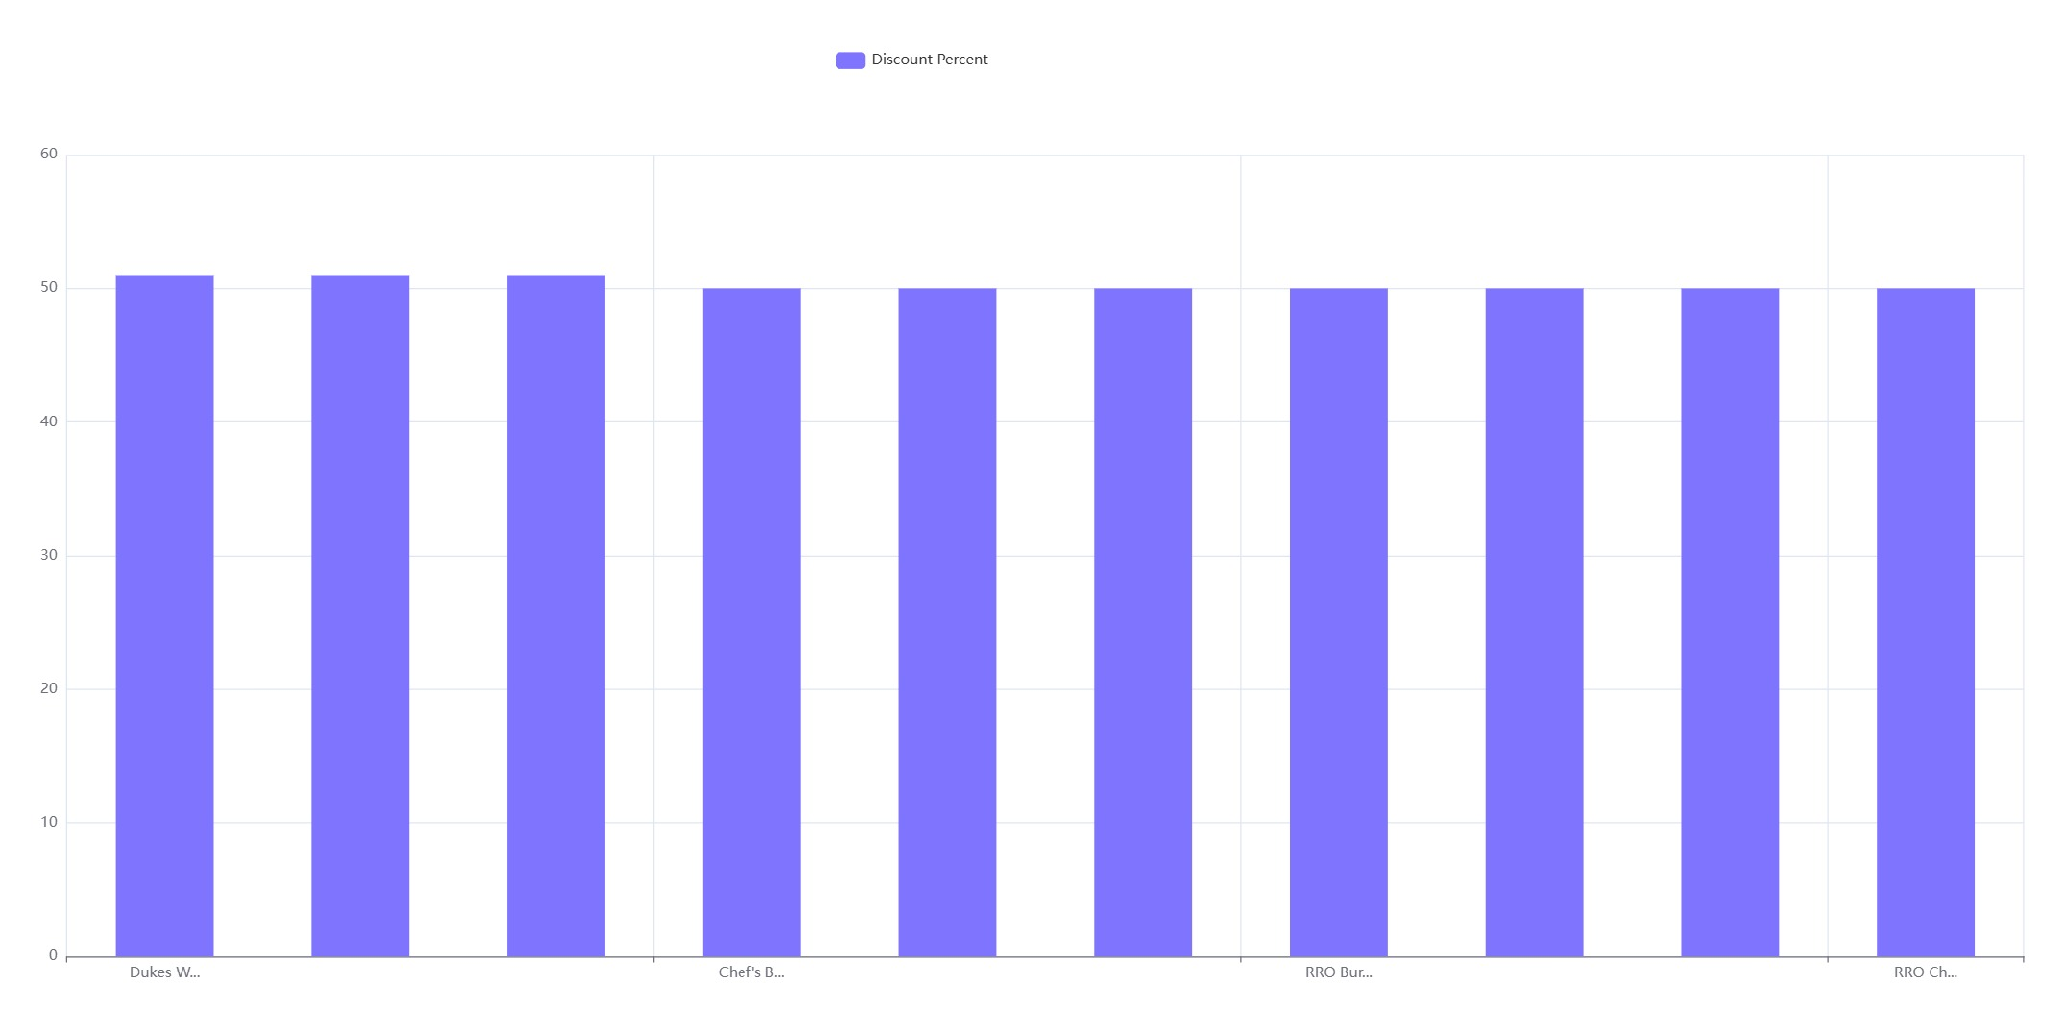

Slide 8
Discount percentage and price correlation
Weak Positive Correlation: The Pearson correlation coefficient of 0.0379 indicates a very weak positive linear relationship between 'discountPercent' and 'discountedSellingPrice'.
Statistical Significance: The correlation is statistically significant with a p-value of 0.0207, suggesting the relationship is unlikely due to chance.
Implications: 'DiscountPercent' is not a strong predictor of 'discountedSellingPrice'; other factors likely have a greater impact.

Slide 9
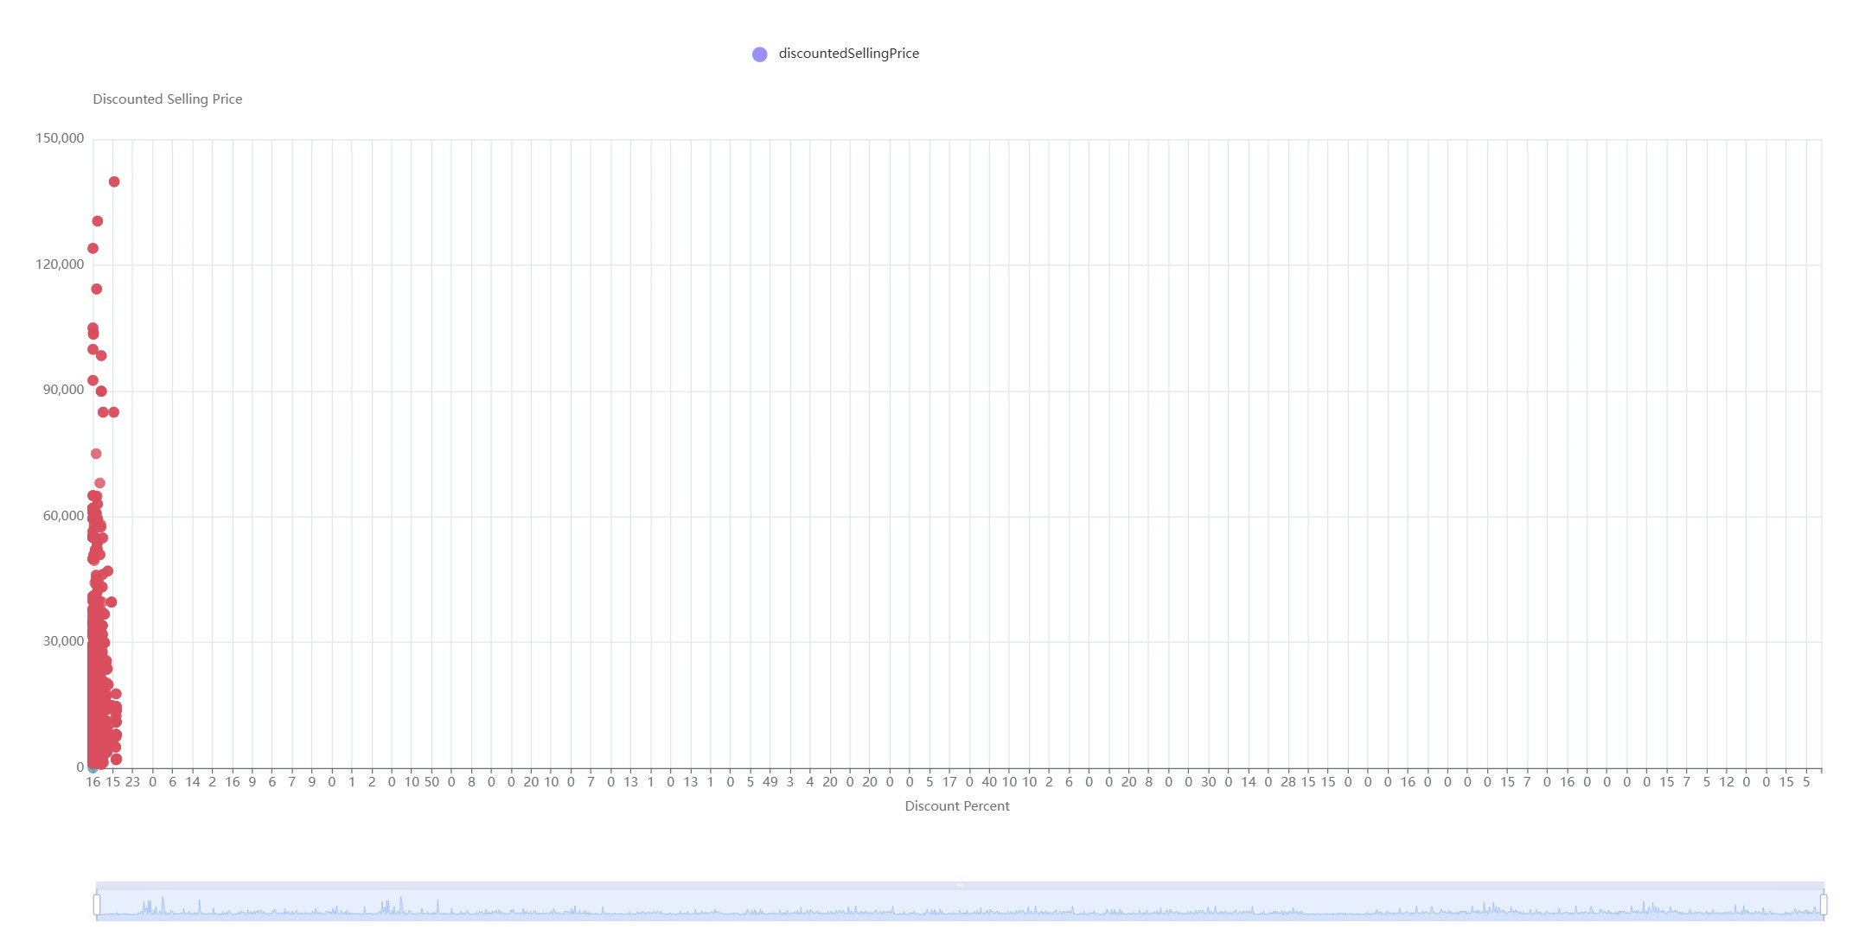

Slide 10
Out-of-stock rates by category
Highest Out-of-Stock Categories: Biscuits (28.57%), Beverages (21.71%), and Dairy, Bread & Batter (21.71%) are critical for inventory management.
Significant Out-of-Stock Rates: Meats, Fish & Eggs (19.05%) face supply chain challenges.
Lowest Out-of-Stock Categories: Paan Corner (6.10%) and Personal Care (6.10%) show efficient inventory management.

Slide 11
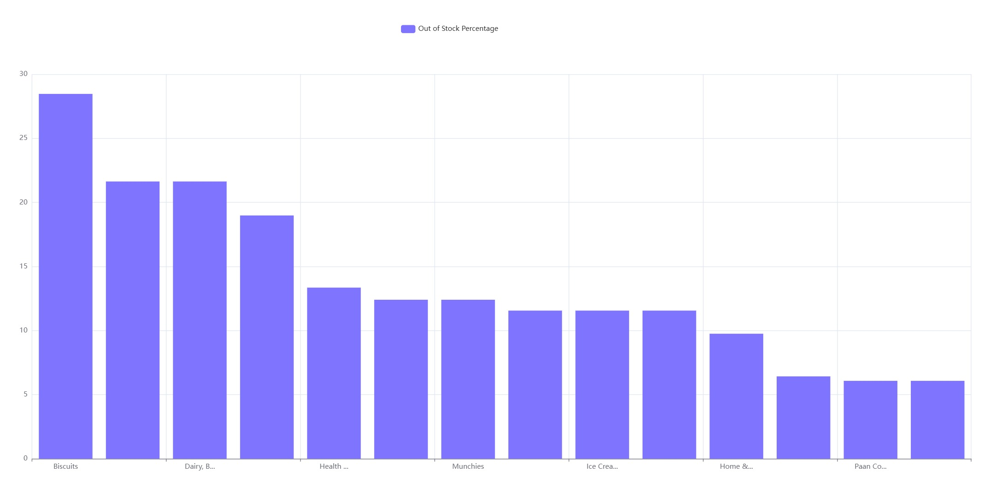

Slide 12
Identify price outliers by category
Identification of Outliers: 192 products with unusual discounts (ranging from 4.55% to 51.11%) were identified using the IQR-based boxplot method across various categories.
Visual Confirmation: Box plots confirmed outliers in categories like 'Fruits & Vegetables' and others.
Actionable Insights: These outliers suggest potential areas for further investigation into pricing strategies.

Slide 13
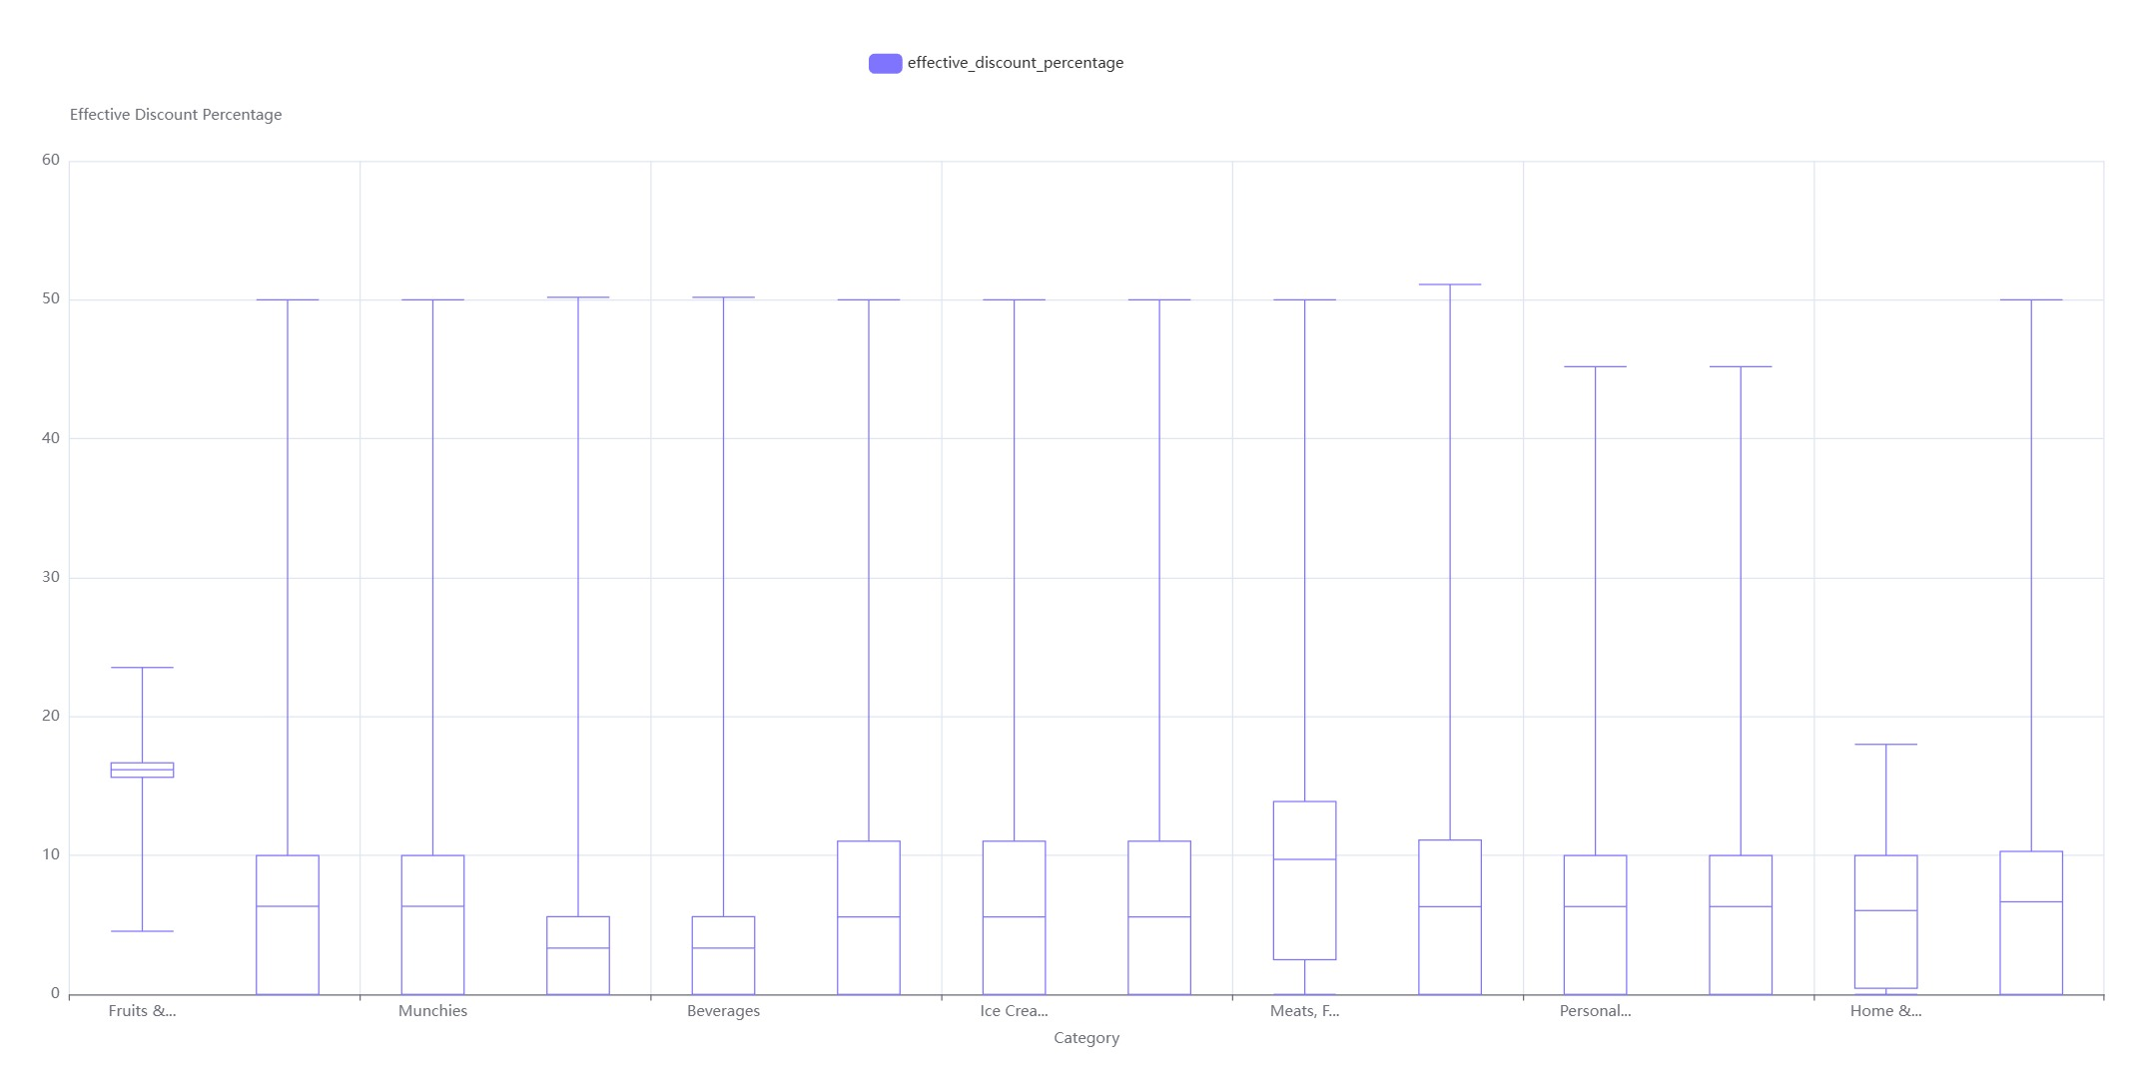

Slide 14
Rank categories by discounted sales
Top-Performing Categories: "Cooking Essentials" and "Munchies" lead with a total discounted selling price of 7,238,500 and 106,489 units sold each.
Mid-Tier Performance: "Paan Corner" and "Personal Care" follow with 6,527,000 in sales.
Lowest-Performing Category: "Fruits & Vegetables" with 370,500 in sales.
Sales vs. Quantity Discrepancies: Notable differences in sales and quantity, e.g., "Health & Hygiene" has low sales but the lowest quantity sold.

Slide 15
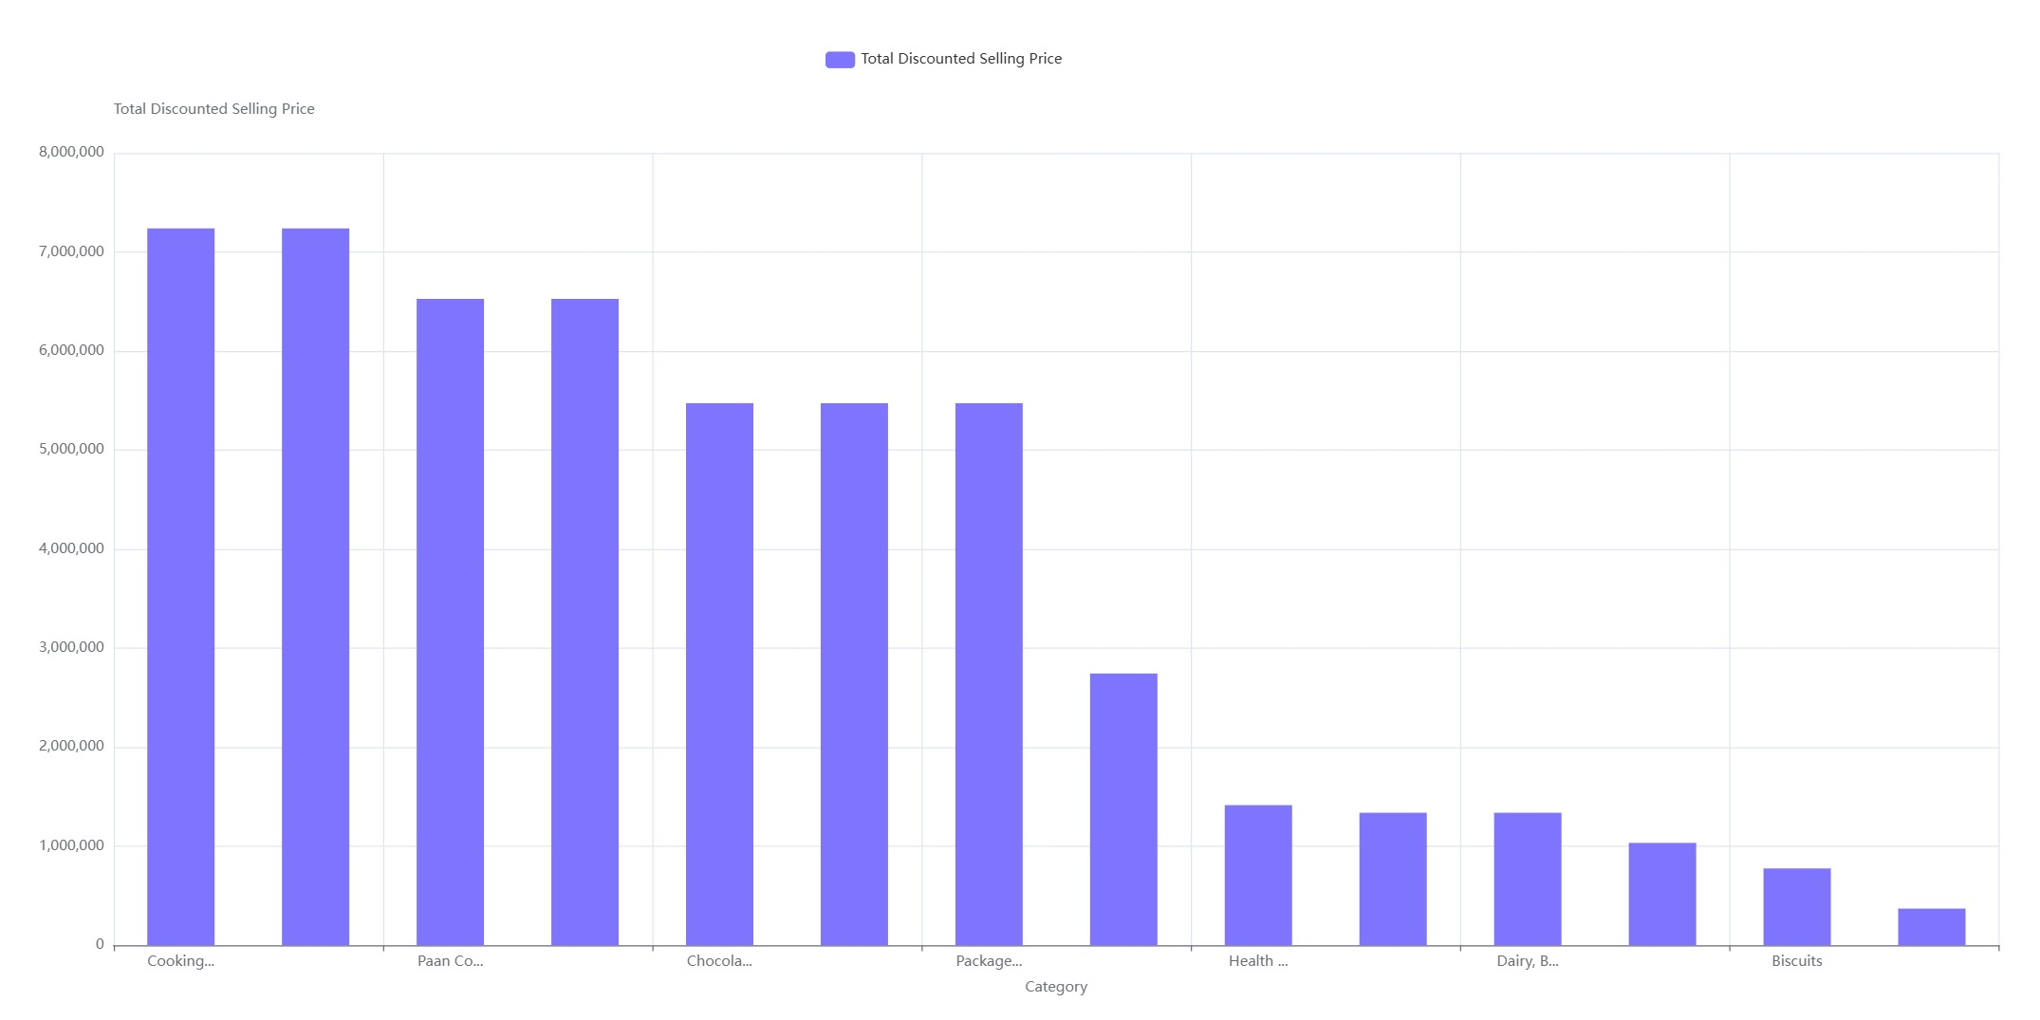

Slide 16
Weight-MRP Correlation by Category
Correlation Variability: The Pearson correlation coefficient between `weightInGms` and `mrp` varies widely across categories, from 0.00 to 0.73, with an average of 0.41.
High Correlation Categories: `Home & Cleaning` (0.73), `Biscuits`, `Chocolates & Candies`, `Ice Cream & Desserts`, and `Packaged Food` show strong correlations.
Low Correlation Categories: `Paan Corner`, `Personal Care`, and others show minimal correlation, indicating other pricing factors are more influential.

Slide 17
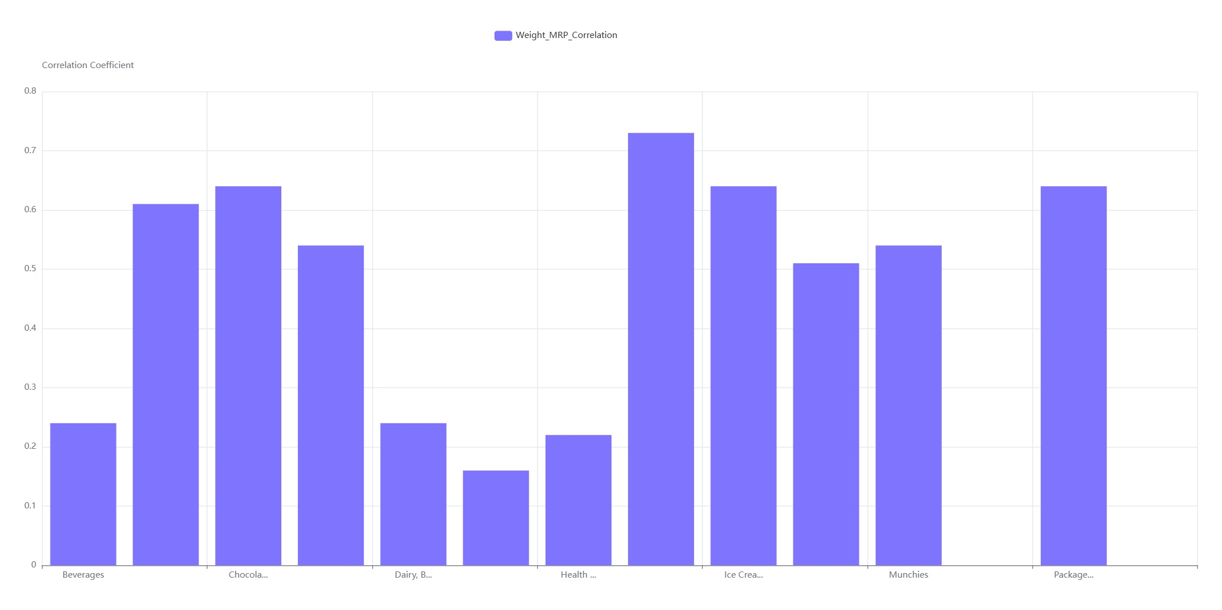

Slide 18
sherinpv141@gmail.com
Sherin P V

